Slide 1
INTERNSHIP TASK -1
PUSH BUTTON COUNTER
KEVIN VICTOR
Intern ID : CTIS8913

Slide 2
TASK 1
USE A TEMPERATURE SENSOR TO READ AND DISPLAY TEMPERATURE DATA ON AN LCD OR SERIAL MONITOR.

Slide 3
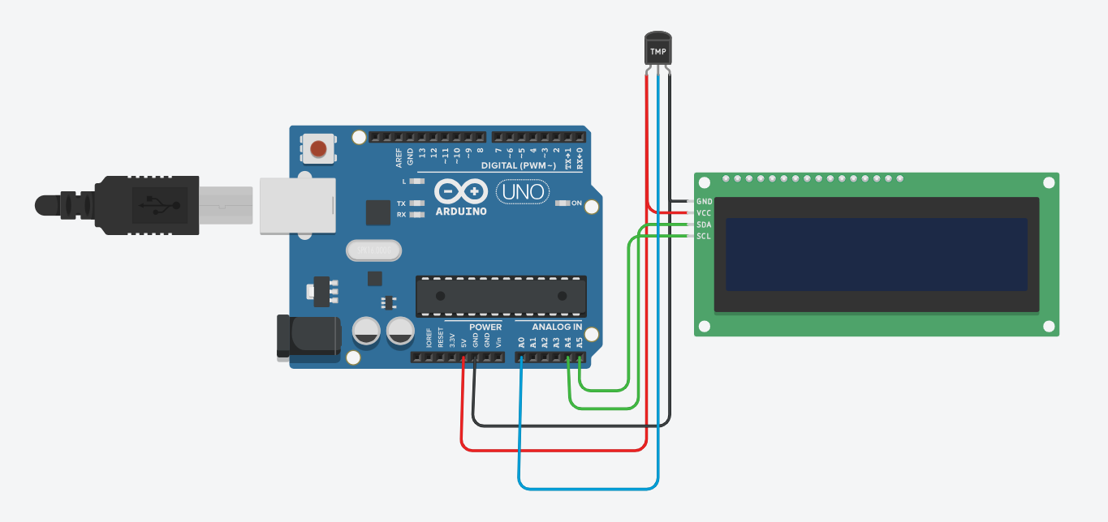
CIRCUIT DESIGN
Components
Temperature sensor - TMP36
Arduino Uno R3
lcd ( 16 X 2 )

Slide 4
CODE
#include <Adafruit_LiquidCrystal.h>
// Includes library to control LCD using I2C (simplifies wiring)
int temp = 0;
// Variable to store calculated temperature value
Adafruit_LiquidCrystal lcd_1(0);
// Create LCD object (I2C address = 0 in Tinkercad default)
void setup()
{
pinMode(A0, INPUT);
// Sets analog pin A0 as input (connected to TMP36 sensor)
Serial.begin(9600);
// Starts serial communication at 9600 baud (for debugging/output)
lcd_1.begin(16, 2);
// Initializes LCD with 16 columns and 2 rows
}
void loop()
{

Slide 5
CODE
// Read analog value from TMP36 sensor (0–1023 range)
int rawValue = analogRead(A0);
// Convert analog reading to temperature using mapping
// Breakdown:
// (analogRead(A0) - 20) → small offset correction
// * 3.04 → scaling factor (approx conversion to voltage/temp)
temp = map(((rawValue - 20) * 3.04), 0, 1023, -20, 120);
Serial.println(temp);
// Print temperature to Serial Monitor
// Set cursor to first row, first column
lcd_1.setCursor(0, 0);
lcd_1.print("Temp. Monitr. system");
// Display system title
// Set cursor to second row, first column
lcd_1.setCursor(0, 1);
lcd_1.print("Temp Value=");
// Display label
// Move cursor to position where value will be shown
lcd_1.setCursor(12, 1);
lcd_1.print(temp);
// Print temperature value on LCD
delay(10);
// Small delay to stabilize readings and avoid flickering
}

Slide 6
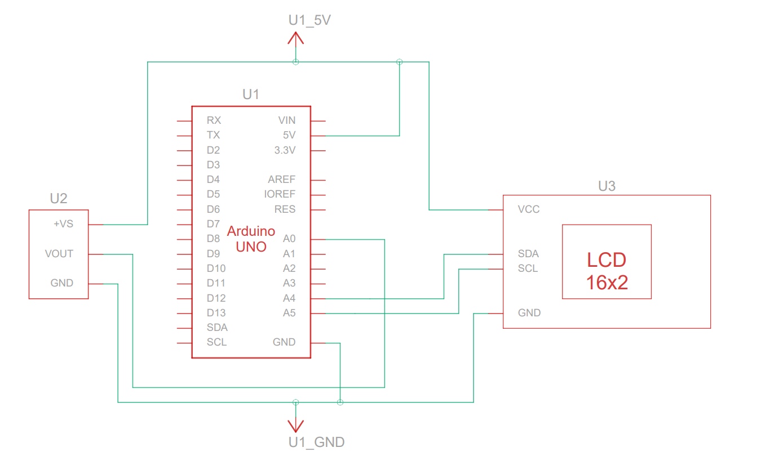
SCHEMATIC VIEW

Slide 7
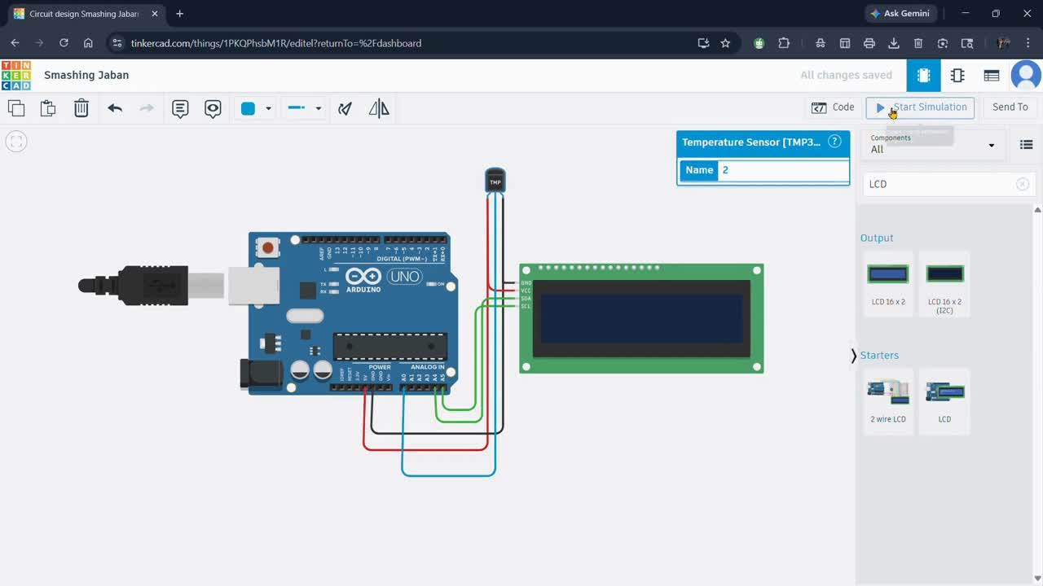
OUTPUT DEMONSTRATION

